Slide 1
EMTH403
Mathematical Foundation for Computer Science

Slide 2
Lecture Outcomes
understand the Division rule in the basics of counting.
understand how to find total number of functions in the basics of counting.

Slide 3
Permutation – Example 1
Ques:- In how many ways can we select three students from a group of five students to stand in line for a picture?
Sol:- By the product rule, there are
5 · 4 · 3 = 60 ways

Slide 4
Permutation – Example 1
5 Choices
4 Choices
3 Choices
1nd
2nd
3rd
S1
S2
S3
S4
S5

Slide 5
Permutation – Example 1
5 Choices
4 Choices
3 Choices
1nd
2nd
3rd
S1
S2
S3
S4
S5

Slide 6
Permutation – Example 1
5 Choices
4 Choices
3 Choices
1nd
2nd
3rd
S1
S2
S3
S4
S5

Slide 7
Permutation – Example 1
5 Choices
4 Choices
3 Choices
1nd
2nd
3rd
S1
S2
S3
S4
S5

Slide 8
Permutation – Example 1
5 Choices
4 Choices
3 Choices
1nd
2nd
3rd
S1
S2
S3
S4
S5

Slide 9
Permutation – Example 1
5 Choices
4 Choices
3 Choices
1nd
2nd
3rd
S1
S2
S3
S4
S5

Slide 10
Permutation – Example 1
5 Choices
4 Choices
3 Choices
1nd
2nd
3rd
S1
S2
S3
S4
S5

Slide 11
Permutation – Example 1
5 Choices
4 Choices
3 Choices
1nd
2nd
3rd
S1
S2
S3
S4
S5

Slide 12
Permutation – Example 1
5 Choices
4 Choices
3 Choices
1nd
2nd
3rd
S1
S2
S3
S4
S5

Slide 13
Permutation – Example 1
5 Choices
4 Choices
3 Choices
1nd
2nd
3rd
S1
S2
S3
S4
S5

Slide 14
Permutation – Example 1
5 Choices
4 Choices
3 Choices
1nd
2nd
3rd
S1
S2
S3
S4
S5

Slide 15
Permutation – Example 1
5 Choices
4 Choices
3 Choices
1nd
2nd
3rd
S1
S2
S3
S4
S5

Slide 16
Permutation – Example 1
5 Choices
4 Choices
3 Choices
1nd
2nd
3rd
S1
S2
S3
S4
S5

Slide 17
Permutation – Example 1
1ST 2ND 3RD
S1 S2 S3
S1 S2 S4
S1 S2 S5
S1 S3 S2
S1 S3 S4
S1 S3 S5
S1 S4 S1
S1 S4 S2
S1 S4 S3
……
S5 S4 S3
5 Choices
4 Choices
3 Choices
1nd
2nd
3rd
S1
S2
S3
S4
S5
Other Cases

Slide 18
Permutation – Example 1
1ST 2ND 3RD
S1 S2 S3
S1 S2 S4
S1 S2 S5
S1 S3 S2
S1 S3 S4
S1 S3 S5
S1 S4 S1
S1 S4 S2
S1 S4 S3
……
S5 S4 S3
5 Choices
4 Choices
3 Choices
1nd
2nd
3rd
S1
S2
S3
S4
S5
Other Cases

Slide 19
Permutation – Example 1
1ST 2ND 3RD
S1 S2 S3
S1 S2 S4
S1 S2 S5
S1 S3 S2
S1 S3 S4
S1 S3 S5
S1 S4 S1
S1 S4 S2
S1 S4 S3
……
S5 S4 S3
5 Choices
4 Choices
3 Choices
1nd
2nd
3rd
S1
S2
S3
S4
S5
By the product rule, there are
5 · 4 · 3 = 60 ways

Slide 20
Permutation – Example 2
Ques:- In how many ways can we arrange all five of these students in a line for a picture?
5 Choices
4 Choices
3 Choices
2 Choices
1 Choices
1nd
2nd
3rd
4th
5th
S1
S2
S3
S4
S5
1ST 2ND 3RD
S1 S2 S3
S1 S2 S3
……
S3 S4 S1
……
S5 S4 S3
4th 5th
S4 S5
S5 S4
….
S2 S5
……
S5 S4
Sol:- By the product rule, there are
5 · 4 · 3 · 2 · 1 = 120 ways

Slide 21
Permutation – Example 2
Ques:- In how many ways can we arrange all five of these students in a line for a picture?
Sol:- By the product rule, there are
5 · 4 · 3 · 2 · 1 = 120 ways
OR
5 · (5-1) · (5-2) · (5-3) · (5-4) = 120 ways
OR
n · (n-1) · (n-2) · (n-3) · (n-4) = 120 ways
Where n=5
OR
n · (n-1) · (n-2) · (n-3) · (n-(r-1)) = 120 ways
where n=5, where r=5.

Slide 22
Permutation – Example 2
Ques:- In how many ways can we arrange all five of these students in a line for a picture?
Sol:- N students and r positions
Total ways = n(n − 1)(n − 2) · · · (n − (r – 1))
Total ways = n(n − 1)(n − 2) · · · (n − r +1)

Slide 23
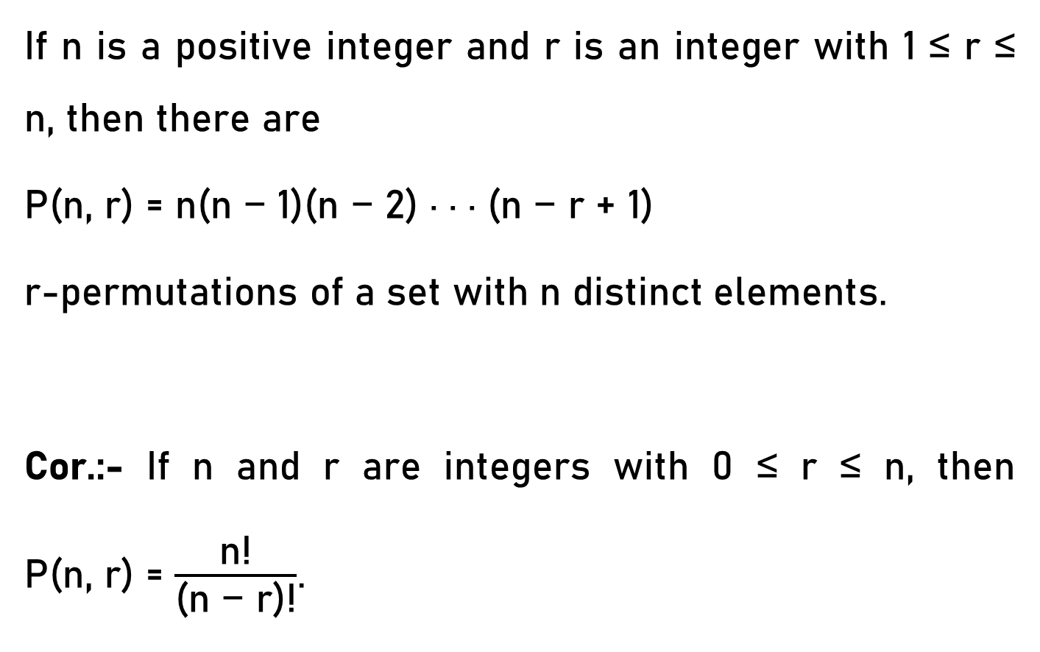
Permutation - Theorem
If n is a positive integer and r is an integer with 1 ≤ r ≤ n, then there are
P(n, r) = n(n − 1)(n − 2) · · · (n − r + 1)
r-permutations of a set with n distinct elements.
Cor.:- If n and r are integers with 0 ≤ r ≤ n, then
P(n, r) = $\frac{\text{n}\text{!}}{\text{(}\text{n}\text{ − }\text{r}\text{)!}}$.

Slide 24
Permutation – Example 3
Ques:- How many ways are there to select a first-prize winner, a second-prize winner, and a third-prize winner from 100 different people who have entered a contest?
Total ways = n(n − 1)(n − 2) · · · (n − (r – 1)) where n=100, r=3.
Total ways = n(n − 1)(n − 2) · · · (n − r +1)

Slide 25
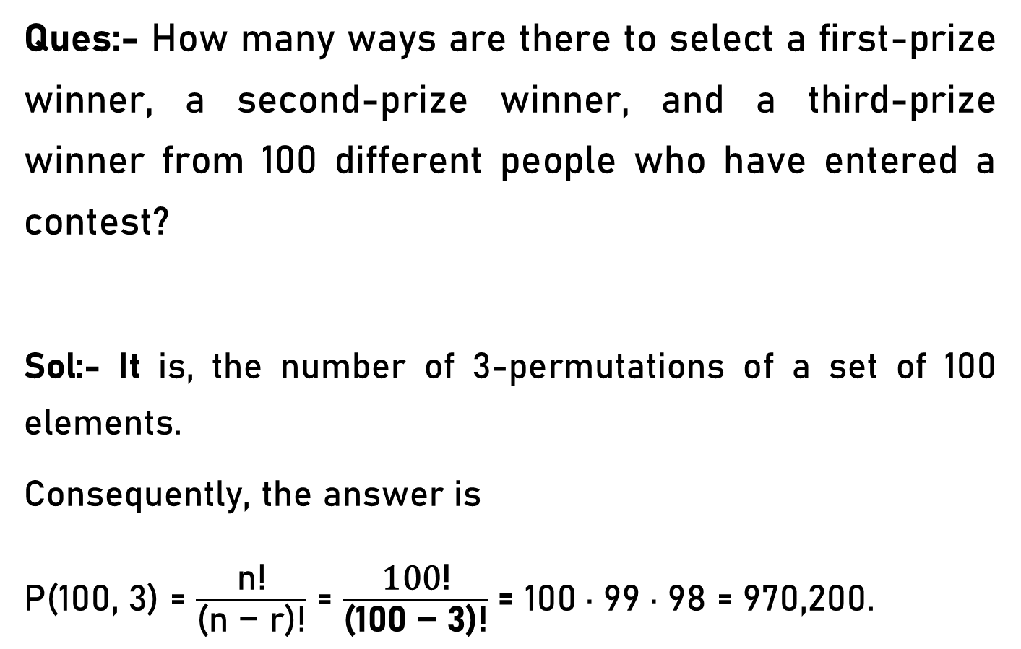
Permutation – Example 3
Ques:- How many ways are there to select a first-prize winner, a second-prize winner, and a third-prize winner from 100 different people who have entered a contest?
Sol:- It is, the number of 3-permutations of a set of 100 elements.
Consequently, the answer is
P(100, 3) = $\frac{\text{n}\text{!}}{\text{(}\text{n}\text{ − }\text{r}\text{)!}}$ = $\frac{\text{100}\text{!}}{\text{(}\text{100}\text{ − }\text{3}\text{)!}}$ = 100 · 99 · 98 = 970,200.

Slide 26
Permutation – Example 4
Ques:- Suppose that there are eight horses in a race. The winner receives a gold medal, the second place finisher receives a silver medal, and the third-place finisher receives a bronze medal. How many different ways are there to award these medals, if all possible outcomes of the race can
occur and there are no ties?

Slide 27
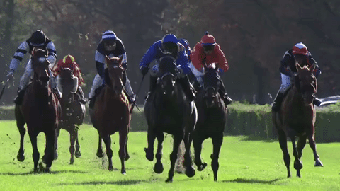
Permutation – Example 4
Sol:- The number of different ways to award the medals is the number of 3-permutations of a set with eight elements.
Hence, there are P(8, 3) = 8 · 7 · 6 = 336 possible ways to award the medals.

Slide 28
Permutation – Example 5
Ques:- How many permutations of the letters ABCDEFGH contain the string ABC ?
Sol:- the letters ABC must occur as a block, we can find the answer by finding the number of permutations of six objects, namely, the block ABC and the individual letters D, E, F, G, and H.

Slide 29
Permutation – Example 5
ABCDEFGH
OR
ABCDEFHG
OR
DABCEFHG
OR
DEABCFHG
OR
DEFHGABC etc.

Slide 30
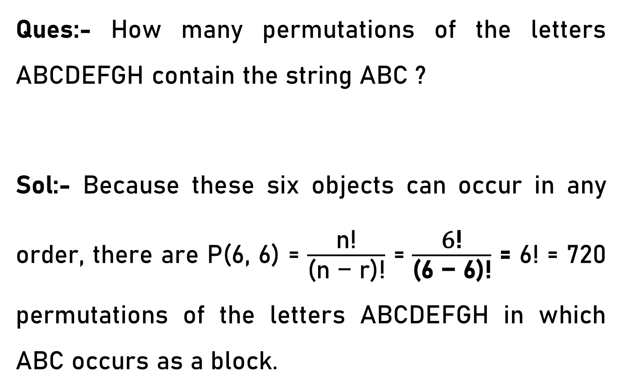
Permutation – Example 5
Ques:- How many permutations of the letters ABCDEFGH contain the string ABC ?
Sol:- Because these six objects can occur in any order, there are P(6, 6) = $\frac{\text{n}\text{!}}{\text{(}\text{n}\text{ − }\text{r}\text{)!}}$ = $\frac{\text{6}\text{!}}{\text{(}\text{6}\text{ − }\text{6}\text{)!}}$ = 6! = 720 permutations of the letters ABCDEFGH in which ABC occurs as a block.

Slide 31
Permutation – Example 6
Ques:- How many permutations of {a, b, c, d, e, f, g} end with a?
Sol:- If we want the permutation to end with a, then we may as well forget about the a, and just count the number of permutations of { b, c, d, e, f, g}.

Slide 32
Permutation – Example 6
b c d e f g a
OR
b c d e g f a
OR
b c d f e g a
OR
c b d e f g a etc.

Slide 33
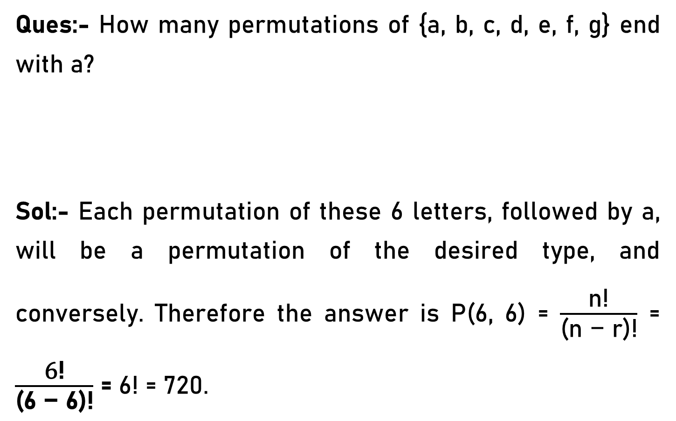
Permutation – Example 6
Ques:- How many permutations of {a, b, c, d, e, f, g} end with a?
Sol:- Each permutation of these 6 letters, followed by a, will be a permutation of the desired type, and conversely. Therefore the answer is P(6, 6) = $\frac{\text{n}\text{!}}{\text{(}\text{n}\text{ − }\text{r}\text{)!}}$ = $\frac{\text{6}\text{!}}{\text{(}\text{6}\text{ − }\text{6}\text{)!}}$ = 6! = 720.

Slide 34
Permutation – Example 7
Ques:- How many ways are there for eight men and five women to stand in a line so that no two women stand next to each other?
Sol:- First position the men and then consider possible positions for the women.

Slide 35
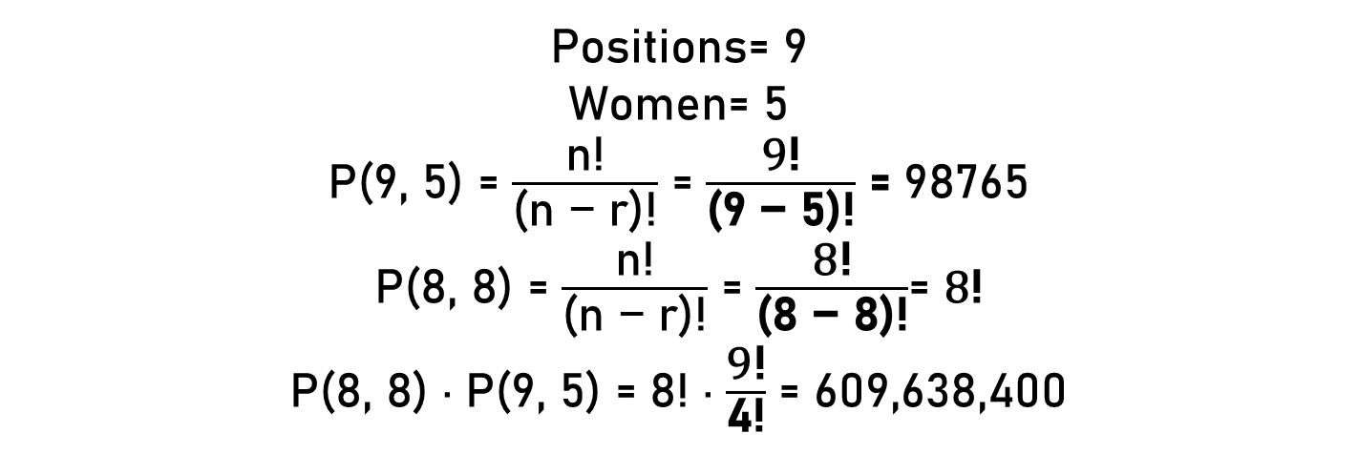
Permutation – Example 7
W1, W2, W3, W4, W5
_ M1_M2_M3_M4_M5_M6_M7_M8_
_ 1_ 2_ 3_ 4_ 5_ 6_ 7_ 8_
Positions= 9
Women= 5
P(9, 5) = $\frac{\text{n}\text{!}}{\text{(}\text{n}\text{ − }\text{r}\text{)!}}$ = $\frac{\text{9}\text{!}}{\text{(}\text{9}\text{ − }\text{5}\text{)!}}$ = 98765
P(8, 8) = $\frac{\text{n}\text{!}}{\text{(}\text{n}\text{ − }\text{r}\text{)!}}$ = $\frac{\text{8}\text{!}}{\text{(}\text{8}\text{ − }\text{8}\text{)!}}$= $\text{8}\text{!}$
P(8, 8) · P(9, 5) = 8! · $\frac{\text{9}\text{!}}{\text{4}\text{!}}$ = 609,638,400

